Slide 1

CONSERVATION BIOLOGY
By Bradley J. Cardinale and James D. Murdoch

Slide 2

2
Notes:
The Bornean peacock-pheasant (Polyplectron schleiermacheri) is one of the rarest peacock pheasants, found only in the lowland forests of Borneo. It is listed as endangered by the International Union for Conservation of Nature’s Red List, mainly as a result of habitat loss associated with large-scale commercial logging and land clearing for rubber and palm oil plantations.

Slide 3
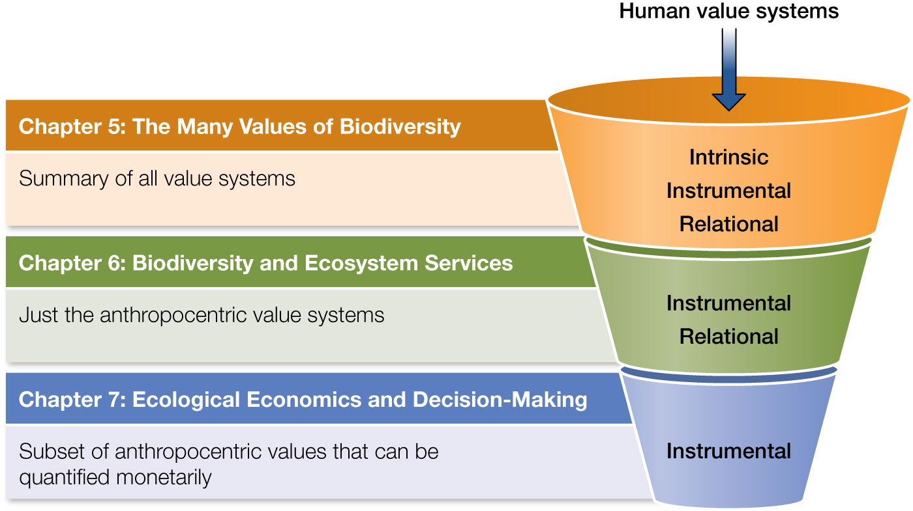
Figure 7.1 A summary of the organization of Part II of this book, which covered the importance of biodiversity. Chapter 5 was the broadest chapter, covering three major human value systems (intrinsic, instrumental, and relational) that influence conservation decisions.
Notes:
Figure 7.1 A summary of the organization of Part II of this book, which covered the importance of biodiversity. Chapter 5 was the broadest chapter, covering three major human value systems (intrinsic, instrumental, and relational) that influence conservation decisions. Chapter 6 focused more narrowly on the subset of anthropocentric values where nature and its biodiversity benefit people. Here in Chapter 7, we focus on the subset of anthropogenic values that can be quantified economically.

Slide 4
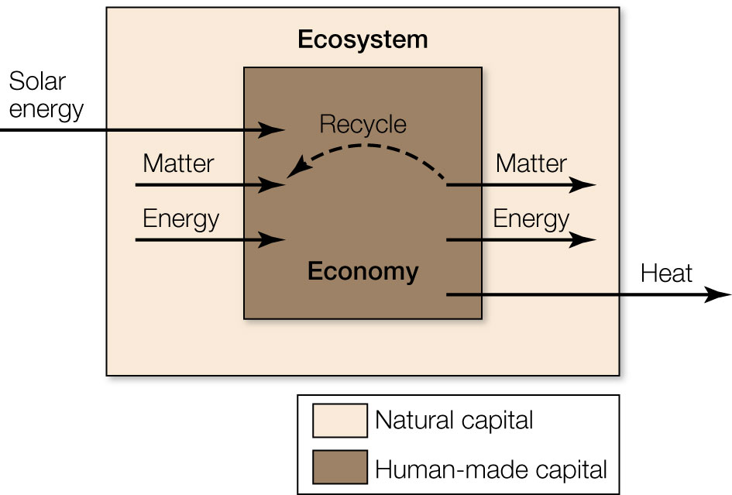
Figure 7.2 Ecological economics addresses the interrelationship between ecological and economic systems.
Notes:
Figure 7.2 Ecological economics addresses the interrelationship between ecological and economic systems. Ecological economics assumes that the human economy, which is based on human-made capital, is but one part of a larger economic system that also includes the natural capital of Earth’s ecosystems.

Slide 5

Figure 7.3 Clean air is an example of an open-access resource that can be compromised when externalities (e.g., pollution) generate market failures that cause the public to bear the costs (e.g., health care, welfare losses) of business transactions.
Notes:
Figure 7.3 Clean air is an example of an open-access resource that can be compromised when externalities (e.g., pollution) generate market failures that cause the public to bear the costs (e.g., health care, welfare losses) of business transactions.

Slide 6

Figure 7.4 Elinor Ostrom is one of just two women to ever win the Nobel Prize in Economics for her work showing that it is possible to manage natural resources in ways that are both economically and ecologically sustainable and that avoid the tragedy of the commons.
Notes:
Figure 7.4 Elinor Ostrom is one of just two women to ever win the Nobel Prize in Economics for her work showing that it is possible to manage natural resources in ways that are both economically and ecologically sustainable and that avoid the tragedy of the commons.

Slide 7
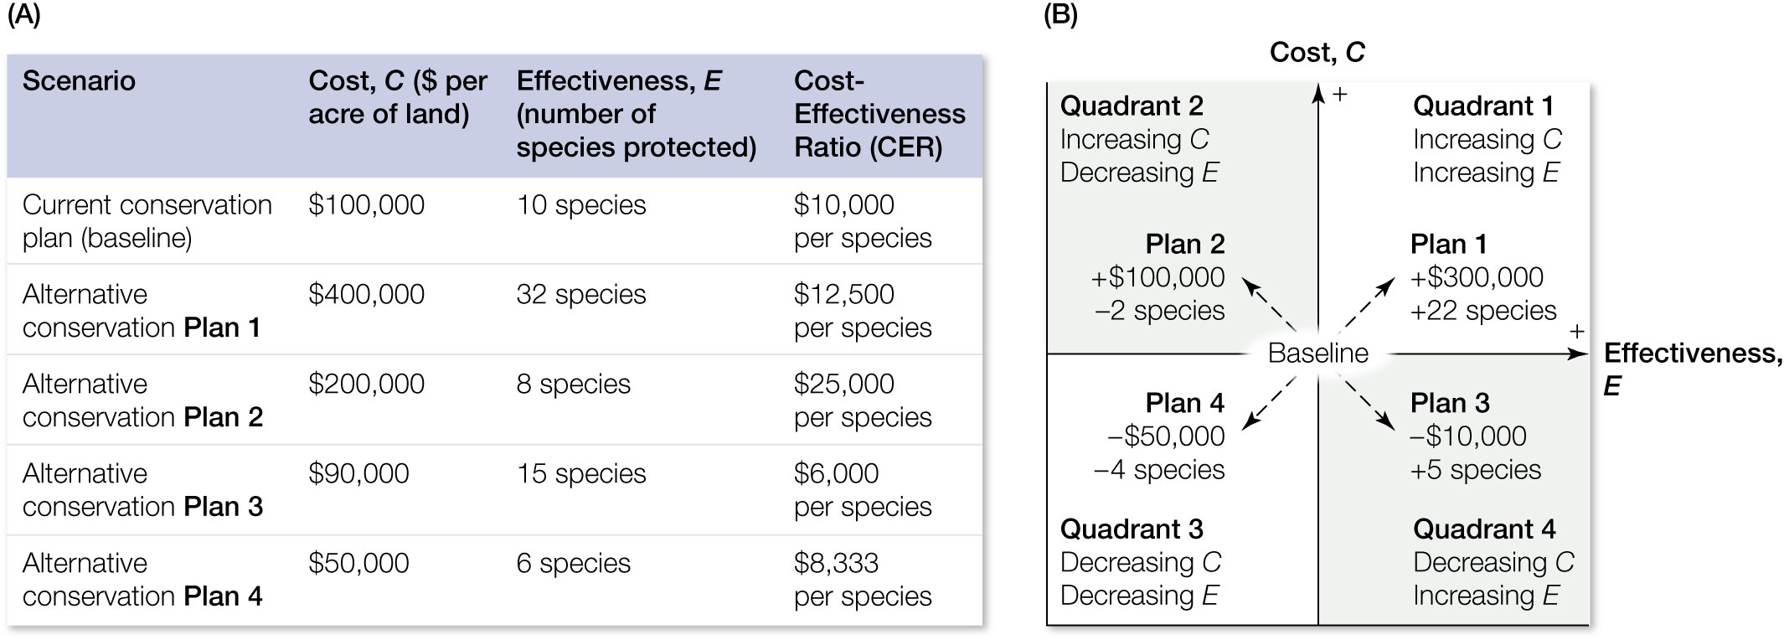
Figure 7.5 An example of a cost-effectiveness analysis. (A) Assume a current conservation plan costs $100,000 per year to protect 10 species.
Notes:
Figure 7.5 An example of a cost-effectiveness analysis. (A) Assume a current conservation plan costs $100,000 per year to protect 10 species. Now assume four alternative plans are being considered (plans 1–4). Each alternative plan has a cost associated with purchasing land that can serve as a protected area, and they differ in the number of threatened plant species that would be protected. The cost-effectiveness ratio can be used to compare alternatives. (B) Alternatives can be plotted on a cost-effectiveness plane to show how they compare with the current conservation baseline (center). In practice, most alternatives fall into quadrants 1 and 3 because cost and effectiveness are correlated. However, occasionally one can find alternatives in quadrant 4 where effectiveness can be increased at a lower cost (e.g., plan 3).

Slide 8
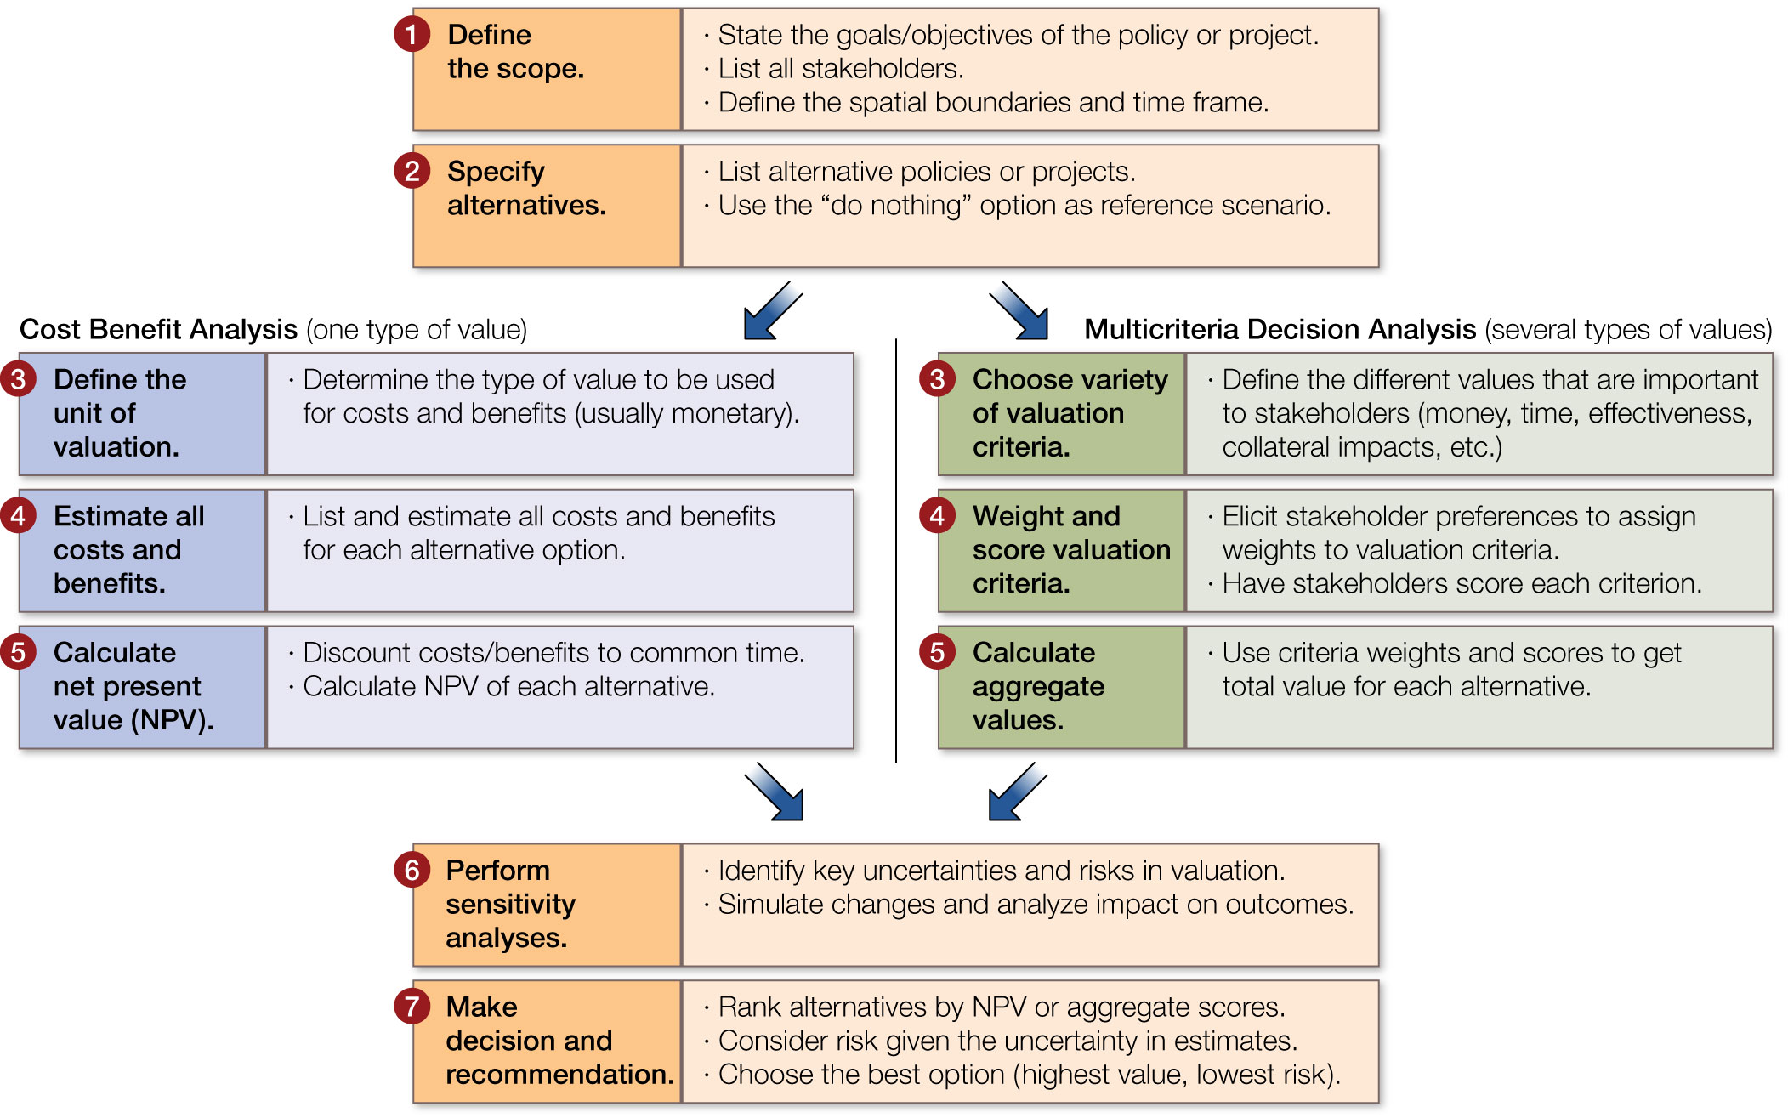
Figure 7.6 Two contrasting methods of decision analysis. Cost–benefit analysis uses a single currency, usually money, to make decisions on a policy or project.
Notes:
Figure 7.6 Two contrasting methods of decision analysis. Cost–benefit analysis uses a single currency, usually money, to make decisions on a policy or project. Multicriteria decision analysis optimizes trade-offs among multiple criteria, where money is but one thing that is valued by stakeholders.

Slide 9
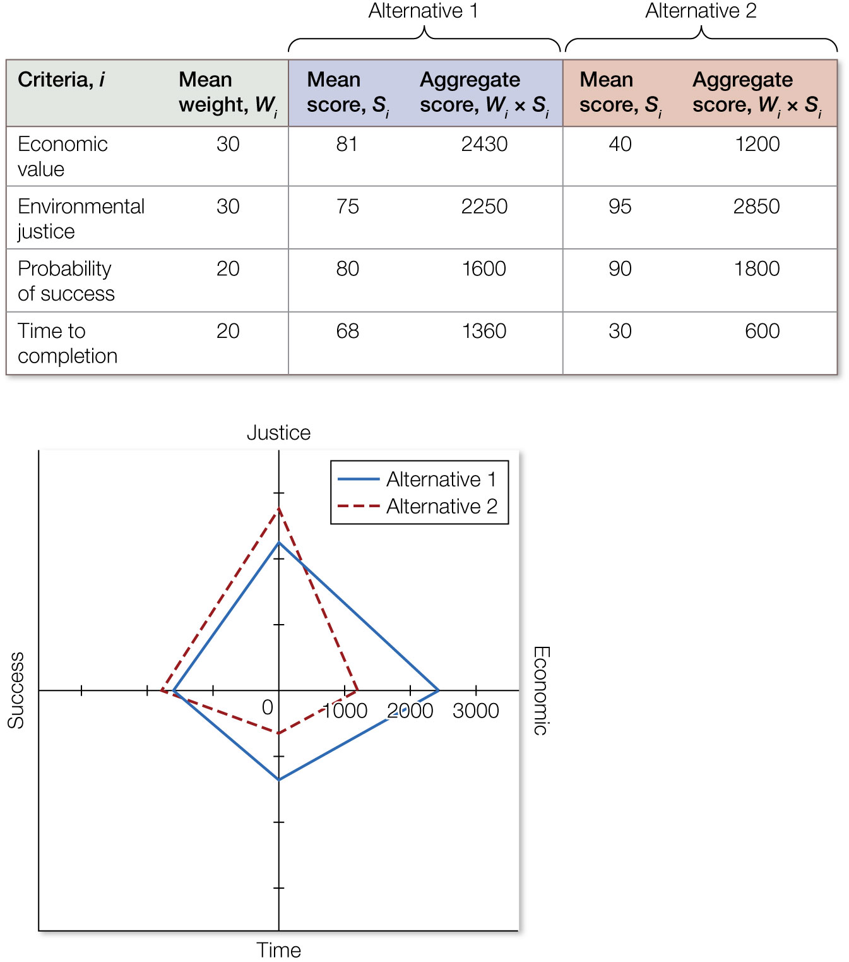
Figure 7.7 An example of output of a multicriteria decision analysis that attempts to optimize trade-offs among four criteria being considered for two alternative projects.
Notes:
Figure 7.7 An example of output of a multicriteria decision analysis that attempts to optimize trade-offs among four criteria being considered for two alternative projects. The web diagram (lower left) clearly shows differences and trade-offs among the two alternatives.

Slide 10
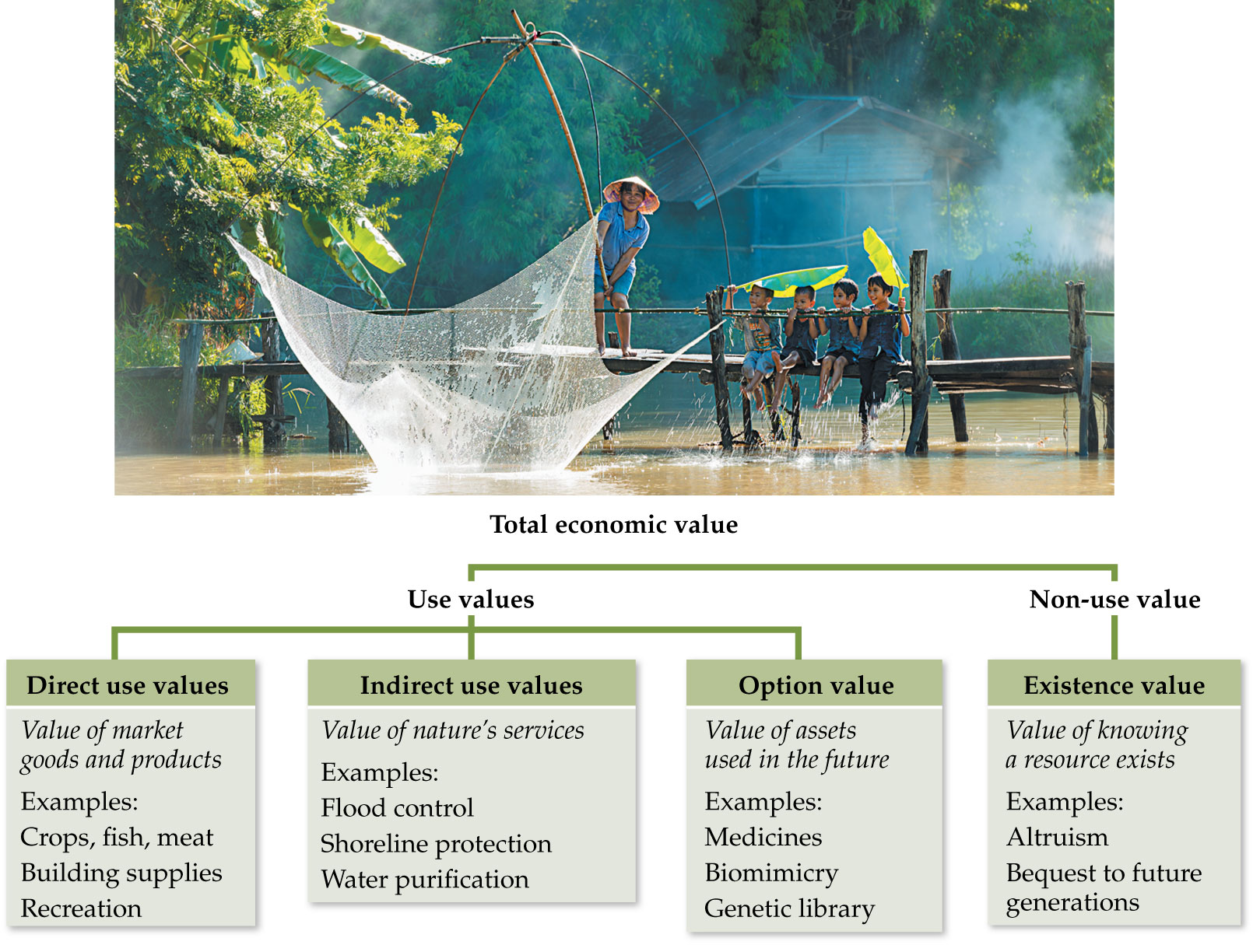
Figure 7.8 The total economic value framework is used to quantify the many different values of an ecosystem and its goods and services to people.
Notes:
Figure 7.8 The total economic value framework is used to quantify the many different values of an ecosystem and its goods and services to people.

Slide 11
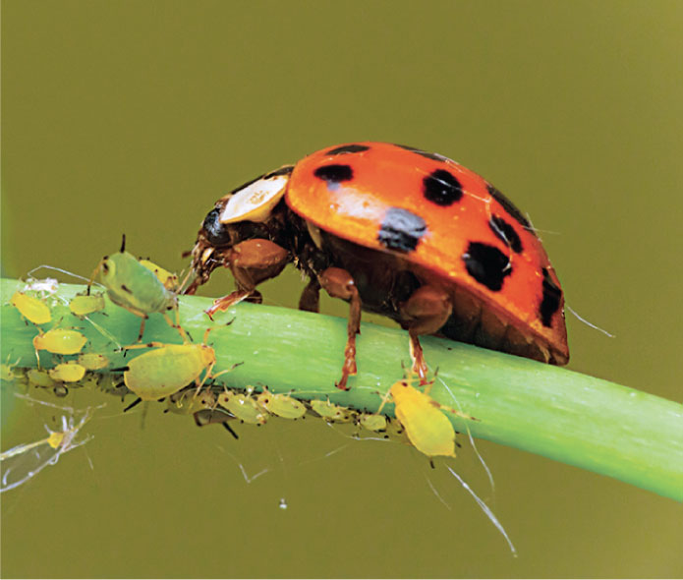
11
Notes:
A lady beetle preys on herbivorous aphids that are attacking a plant.

Slide 12

Figure 7.9 Charismatic megafauna often have a high existence value, where people are willing to pay for their continued existence even though they will never experience them personally.
Notes:
Figure 7.9 Charismatic megafauna often have a high existence value, where people are willing to pay for their continued existence even though they will never experience them personally.

Slide 13
TABLE 7.1 Examples of studies that have attempted to quantify the total economic value (TEV) of ecosystems by calculating the various types of values
Ecosystem | TEV | Direct use value | Indirect use value | Options value | Existence value
Forests in Mexico³² | $42,685,004,179 nationally per year | $34,267,588,011 (80.3%) | $7,628,704,777 (17.9%) | $667,556,950 (1.6%) | $121,154,441 (<1%)
Forests in Turkey³³ | $1,831,809,157 nationally per year | $1,494,762,715 (81.6%) | $196,078,142 (10.7%) | $139,260,044 (7.6%) | $1,708,256 (<1%)
Tropical forests in Brazil³⁴ | $2,012 per hectare per year | $948 (47.1%) | $715 (35.5%) | $31 (1.5%) | $318 (15.8%)
Mangrove forests in Indonesia³⁵ | $379,616 per hectare per year | $13,973 (3.7%) | $362,835 (95.6%) | $1,240 (<1%) | $1,568 (<1%)
UNESCO World Heritage Site—Viñales Valley, Cuba³⁶ | $281,803 per hectare | $14,075 (5.0%) | $34,586 (12.3%) | $64,534 (22.9%) | $168,608 (59.8%)
Note: Monetary estimates from the original studies have been converted to 2018 U.S. dollars. Values in parentheses represent percentages of TEV.
Notes:
TABLE 7.1 Examples of studies that have attempted to quantify the total economic value (TEV) of ecosystems by calculating the various types of values

Slide 14
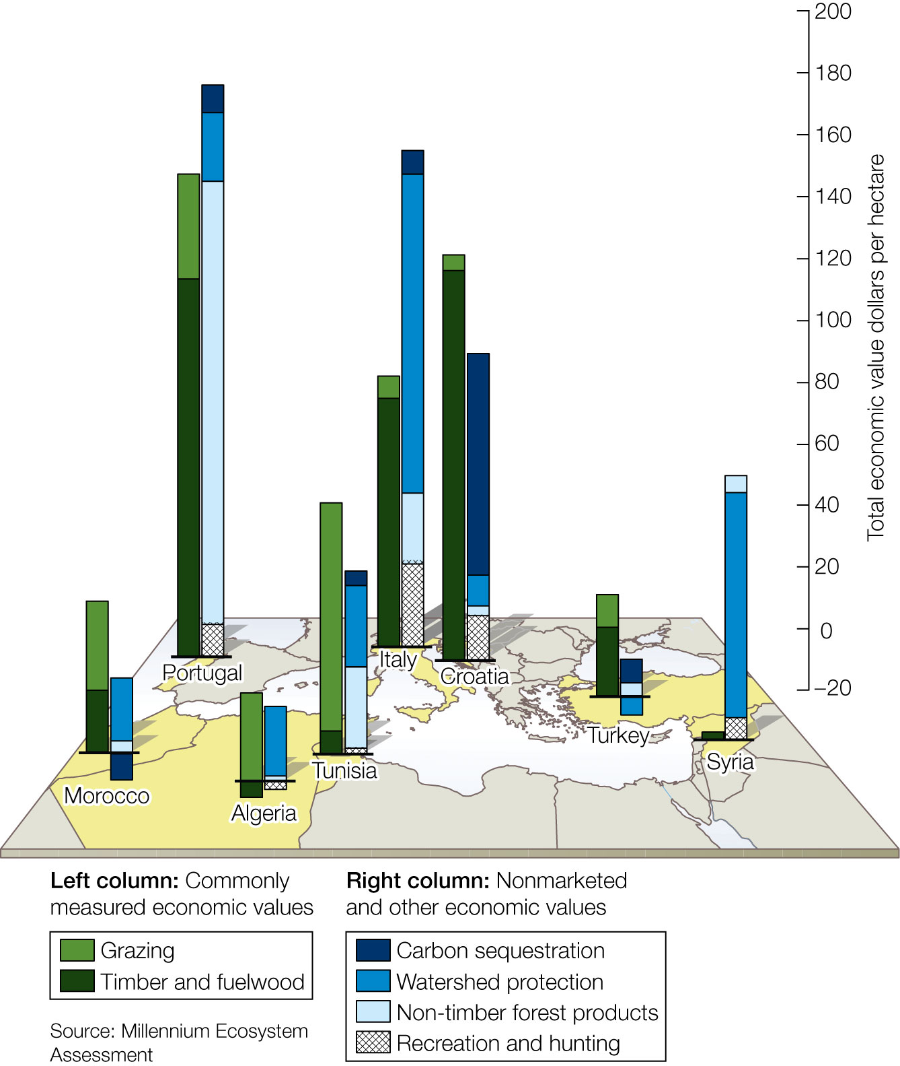
Figure 7.10 The value of forest ecosystem services in select countries.
Notes:
Figure 7.10 The value of forest ecosystem services in select countries. Note that in most countries considered, the commonly measured economic value of market goods (e.g., grazing, timber, fuelwood) is less than the nonmarket value of important ecosystem services (e.g., carbon sequestration, watershed protection, non-timber products, recreation and hunting).

Slide 15
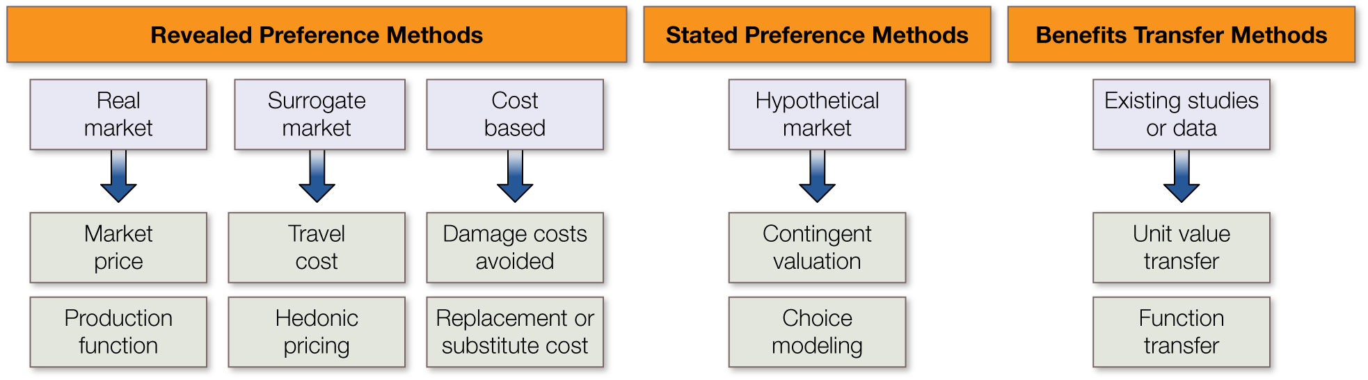
Figure 7.11 A classification of methods that can be used to assign monetary value to various ecosystem services.
Notes:
Figure 7.11 A classification of methods that can be used to assign monetary value to various ecosystem services.

Slide 16
TABLE 7.2 Summary of valuation methods used to assign monetary value to ecosystem services
Method | Overview | Types of value | Example applications
Market price | Estimates value of ecosystem services that are bought and sold in commercial markets | Direct use value | Calculating the economic value of wild fisheries³⁹ or forest timber harvests⁴⁰
Production function | Estimates value of ecosystem services that contribute to the production of goods that are bought and sold in commercial markets | Direct and indirect use values | Estimating value of natural pollinators for crop yield⁴¹ or wetland habitat for fish production²¹
Travel cost | Estimates people’s willingness to pay to visit and recreate at an ecosystem | Indirect use value | Estimating recreational value of coral reefs,⁴² fishing,⁴³ or natural wonders⁴⁴
Hedonic pricing | Evaluates the impact of ecosystem services on properties bought and sold in commercial markets | Indirect use value | Use of housing sales prices to estimate the value of lake water quality,⁴⁵ urban green spaces,⁴⁶ or views of nature⁴⁷
Damage cost avoided | Estimates the cost of avoiding damages that would occur because of loss of an ecosystem service | Indirect use and option values | Estimating cost of destroying mangrove forests for storm protection⁴⁸ or cost of an invasive species⁴⁹
Notes:
TABLE 7.2 Summary of valuation methods used to assign monetary value to ecosystem services

Slide 17
TABLE 7.2 (Continued)
Method | Overview | Types of value | Example applications
Replacement or substitute cost | Estimates the cost of replacing an ecosystem service or of providing a substitute service | Indirect use and option values | Estimating cost to replace pollution removal from a river⁵⁰ or to substitute infrastructure for natural flood control⁵¹
Contingent valuation | Estimates people’s willingness to pay for an ecosystem service on a hypothetical market | Existence value | Estimating the value of a threatened species⁵² or impact of an oil spill on a pristine ecosystem⁵³
Choice modeling | Quantifies people’s preferences between alternative levels of ecosystem services at a given price or cost to the individual | Indirect use, option, and existence values | Estimating people’s willingness to pay for bird- watching⁵⁴ or acceptability of alternative management scenarios⁵⁵
Benefits transfer | Estimates values of an ecosystem service by transferring information from studies already completed in another location and/or context | All | Estimating value of threatened species in developing countries using studies performed in developed countries⁵⁶ or willingness to pay for water quality in one location based on studies performed at another⁵⁷
Notes:
TABLE 7.2 Summary of valuation methods used to assign monetary value to ecosystem services

Slide 18
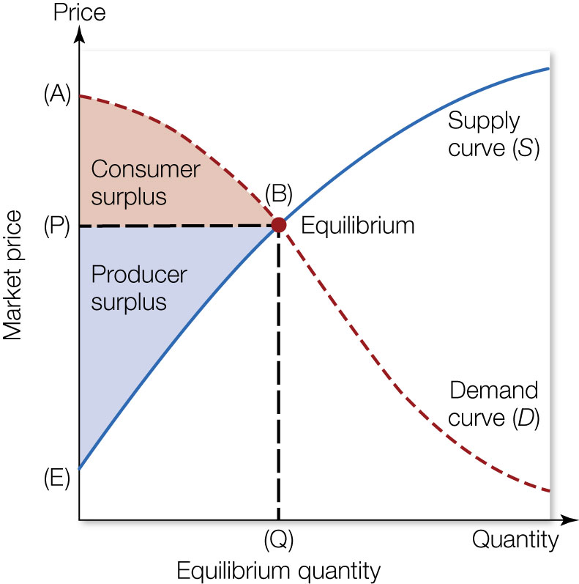
Figure 7.12 The market pricing method quantifies the value of an ecosystem service using the supply curve (solid blue line, S) and demand curve (dashed red line, D) to estimate the total net economic benefit (economic surplus) of the service.
Notes:
Figure 7.12 The market pricing method quantifies the value of an ecosystem service using the supply curve (solid blue line, S) and demand curve (dashed red line, D) to estimate the total net economic benefit (economic surplus) of the service. The intersection of the supply and demand curves (point B) sets a price P and quantity Q for the service. The net economic benefit of the service can be calculated as the sum of consumer surplus (triangle ABP) and producer surplus (triangle BEP).

Slide 19
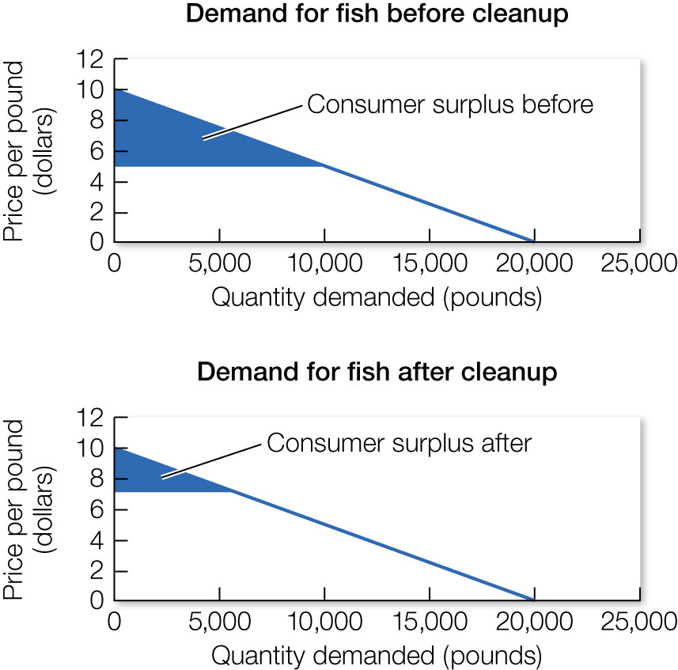
19
Notes:
The demand curves relating the price of fish (y axis) to the quantity demanded (x axis) before cleaning up the lake (top) and after cleaning up the lake (bottom). The difference between consumer surplus before and after represents the value of cleaning up the lake for fish sales.

Slide 20
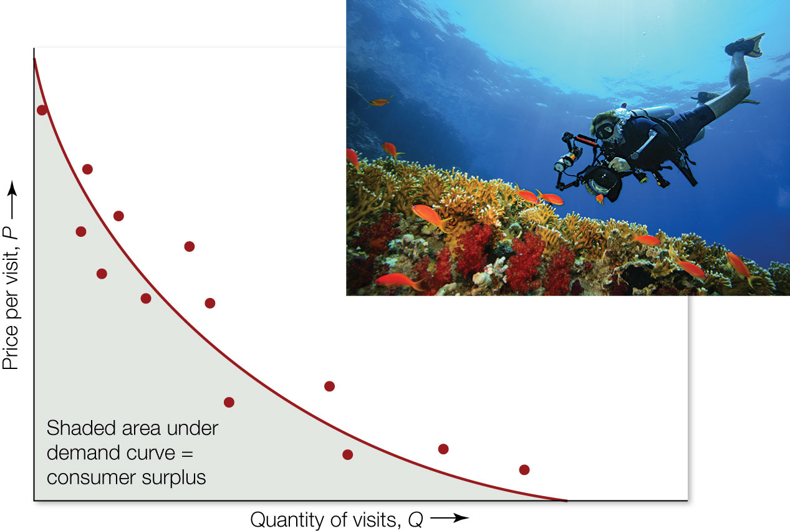
Figure 7.13 The travel cost method generates a demand curve by relating the price per visit to an ecosystem or site (y axis) to the quantity of visits (x axis) made by different individuals (data points).
Notes:
Figure 7.13 The travel cost method generates a demand curve by relating the price per visit to an ecosystem or site (y axis) to the quantity of visits (x axis) made by different individuals (data points). The area under the curve quantifies consumer surplus, which is a measure of the economic value of the site to consumers.

Slide 21
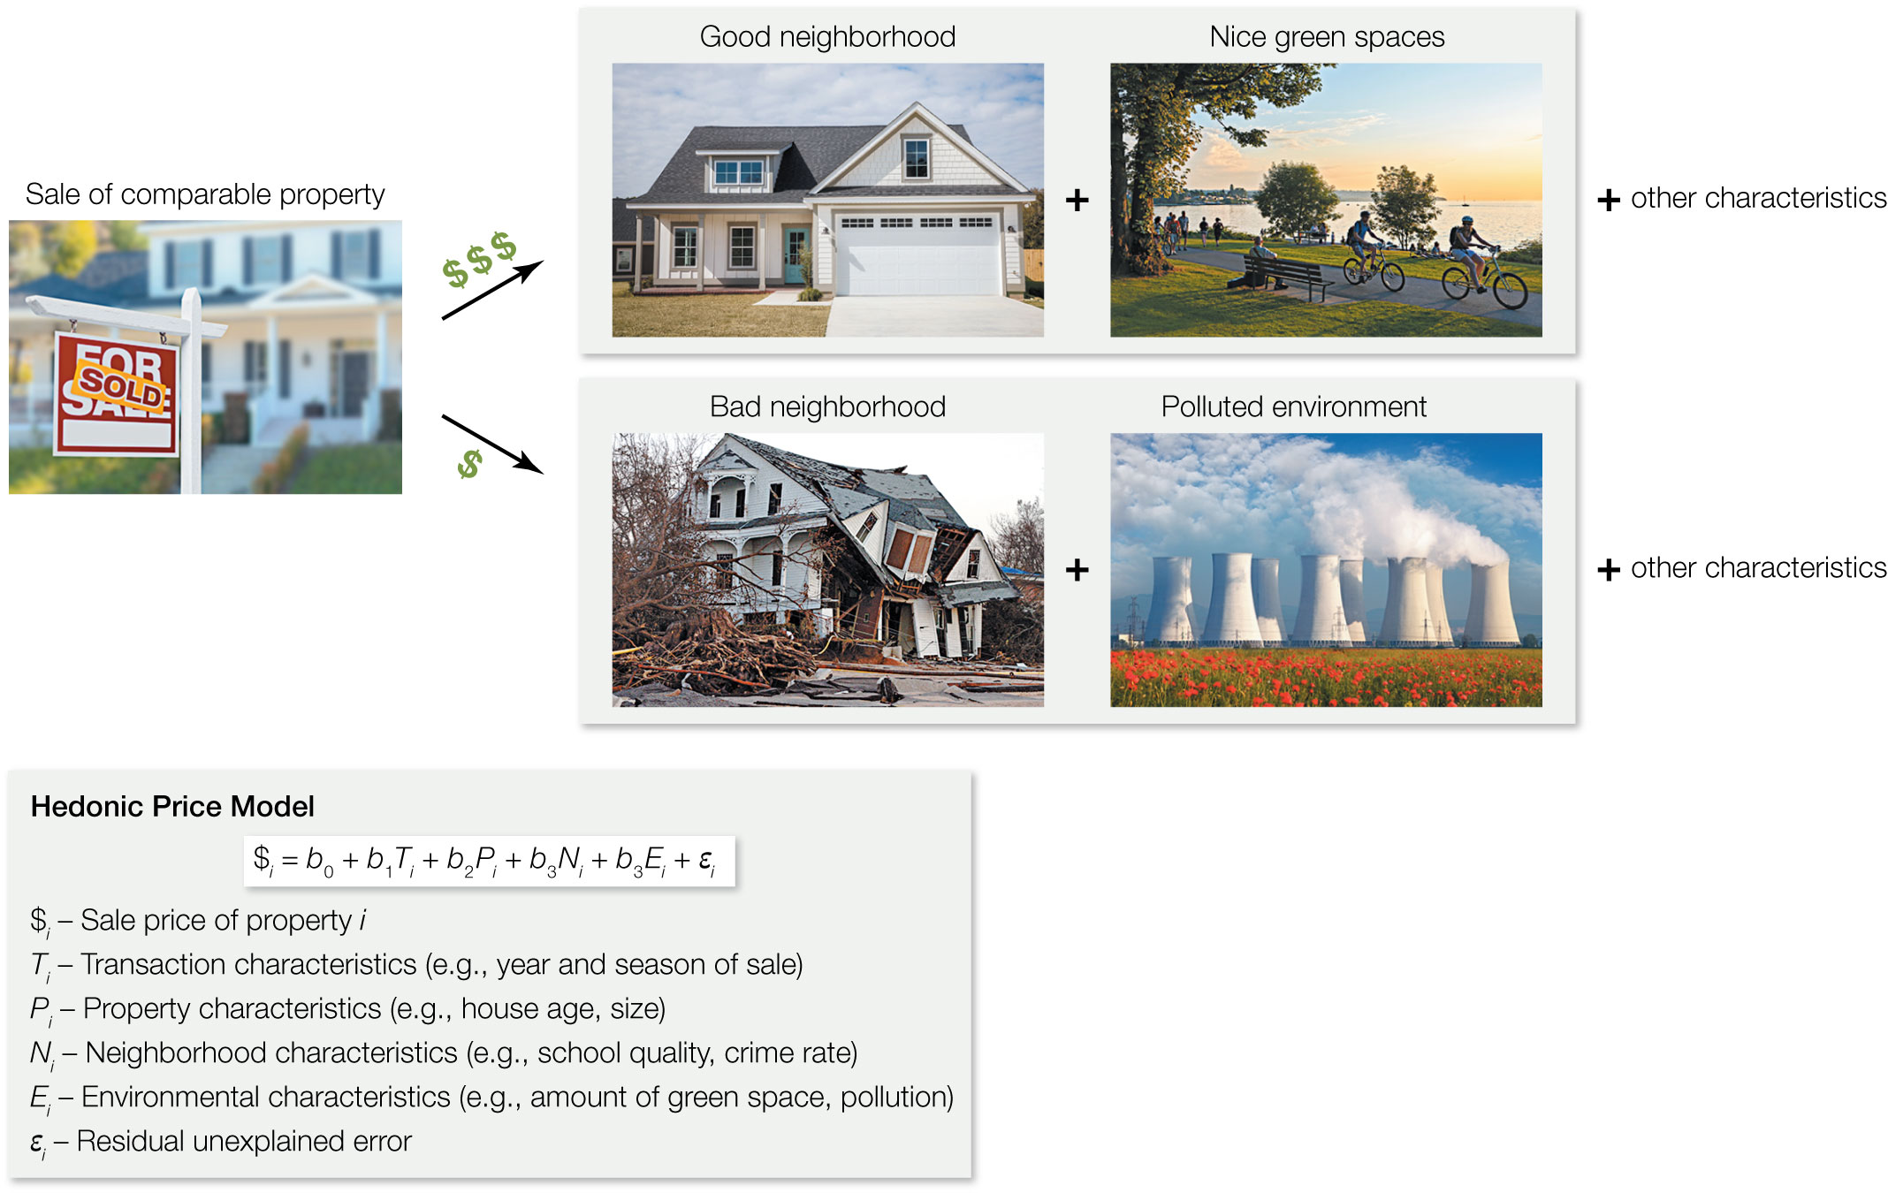
Figure 7.14 The hedonic pricing method uses variation in housing or other real estate prices to estimate the value of different characteristics of the property.
Notes:
Figure 7.14 The hedonic pricing method uses variation in housing or other real estate prices to estimate the value of different characteristics of the property. These characteristics can include local environmental attributes that represent an ecosystem service.

Slide 22
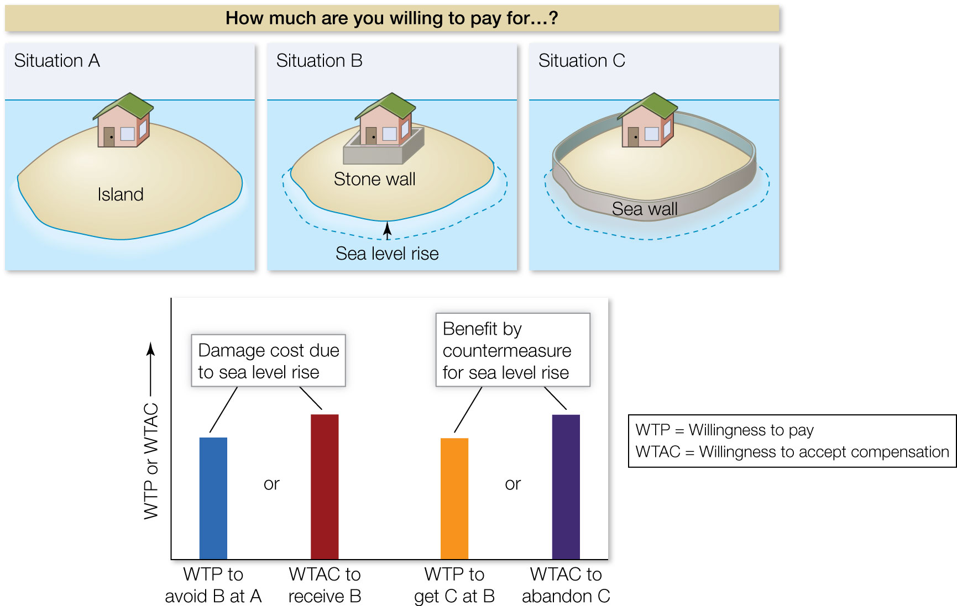
Figure 7.15 Contingent valuation is a stated preference method that involves surveying people to ask how much they would be willing to pay (WTP) for an ecosystem service or what their willingness is to accept compensation (WTAC) to give up an ecosystem service.
Notes:
Figure 7.15 Contingent valuation is a stated preference method that involves surveying people to ask how much they would be willing to pay (WTP) for an ecosystem service or what their willingness is to accept compensation (WTAC) to give up an ecosystem service.

Slide 23
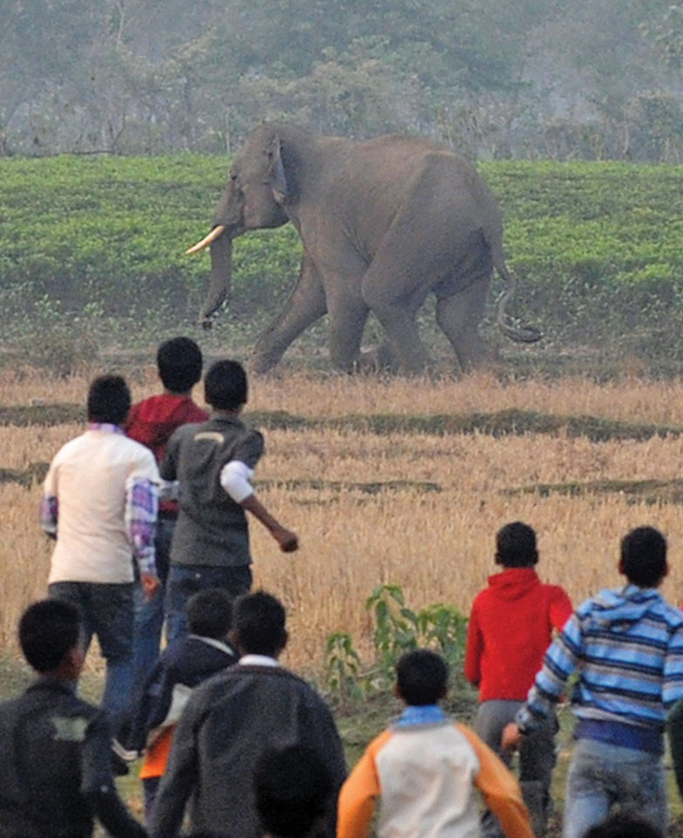
23
Notes:
Man versus elephant. Villagers try to protect their crops from raiding elephants.

